Slide 1
Lecture-1
Introduction to C

Slide 2
We’ll Learn Today:
History of C
Characteristics of C
Writing C Programs
Compilation
Anatomy of C Program
Variables

Slide 3
History of C
The milestones in C's development as a language are listed below:
C evolved from two previous languages, BCPL and B.
BCPL was developed as a language for writing operating-systems software and compilers.
Ken Thompson modeled many features in his B language after their counterparts in BCPL, and in 1970 he used B to create early versions of the UNIX operating system
The C language was evolved from B by Dennis Ritchie at Bell Laboratories.
C became widely known as the development language of the UNIX operating system.

Slide 4
Characteristics of C
Small size
Extensive use of function calls
Loose typing
Structured language
Low level programming readily available
Pointer implementation - extensive use of pointers for memory, array, structures and functions.

Slide 5
C has now become a widely used professional language for various reasons.
It has high-level constructs.
It can handle low-level activities.
It produces efficient programs.
It can be compiled on a variety of computers.

Slide 6
Writing C Program
A programmer uses a text editor to create or modify files containing C code.
Code is also known as source code.
A file containing source code is called a source file.
After a C source file has been created, the programmer must invoke the C compiler before the program can be executed (run).

Slide 7
3 Stages of Compilation
Stage 1: Preprocessing
Performed by a program called the preprocessor
Modifies the source code (in RAM) according to preprocessor directives (preprocessor commands) embedded in the source code
skips comments and white space from the code
The source code as stored on disk is not modified.

Slide 8
3 Stages of Compilation (con’t)
Stage 2: Compilation
Performed by a program called the compiler
Translates the preprocessor-modified source code into object code (machine code)
Checks for syntax errors and warnings
Saves the object code to a disk file, if instructed to do so (we will not do this).
If any compiler errors are received, no object code file will be generated.
An object code file will be generated if only warnings, not errors, are received.

Slide 9
3 Stages of Compilation (con’t)
Stage 3: Linking
Combines the program object code with other object code to produce the executable file.
The other object code can come from the Run-Time Library, other libraries, or object files that you have created.
Saves the executable code to a disk file.
If any linker errors are received, no executable file will be generated.

Slide 10
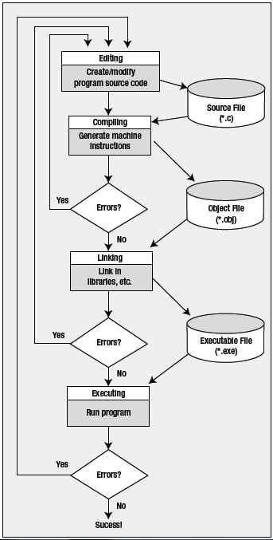
Architectural Diagram

Slide 11
A Simple C Program
/* Filename: hello.c
Author: FAST
Date written: ?/?/2017
Description: This program prints the greeting “Hello, World!”
*/
#include <stdio.h>
void main ( void )
{
printf ( “Hello, World!\n” ) ;
getch( ) ;
}

Slide 12
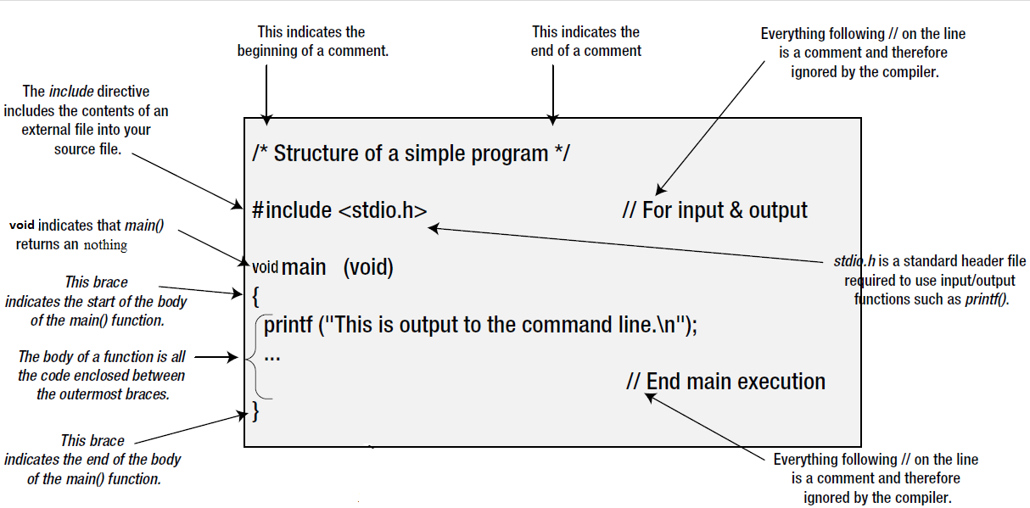
Anatomy of a C Program

Slide 13
Program Header Comment
A comment is descriptive text used to help a reader of the program understand its content.
All comments must begin with the characters /* and end with the characters */
These are called comment delimiters
The program header comment always comes first.

Slide 14
Preprocessor Directives
Lines that begin with a # in column 1 are called preprocessor directives (commands).
Example: the #include <stdio.h> directive causes the preprocessor to include a copy of the standard input/output header file stdio.h at this point in the code.
This header file was included because it contains information about the printf ( ) function that is used in this program.

Slide 15
stdio.h
When we write our programs, there are libraries of functions to help us so that we do not have to write the same code over and over.
Some of the functions are very complex and long. Not having to write them ourselves make it easier and faster to write programs.
Using the functions will also make it easier to learn to program!

Slide 16
void main (void)
Every program must have a function called main. This is where program execution begins.
main() is placed in the source code file as the first function for readability.
The reserved word “void” indicates that main() returns nothing.
The parentheses following the reserved word “main” indicate that it is a function.
The reserved word “void” means nothing is there.

Slide 17
The Function Body
A left brace (curly bracket) -- { -- begins the body of every function. A corresponding right brace -- } -- ends the function body.
The style is to place these braces on separate lines in column 1 and to indent the entire function body 3 to 5 spaces.

Slide 18
printf (“Hello, World!\n”);
This line is a C statement.
It is a call to the function printf ( ) with a single argument (parameter), namely the string “Hello, World!\n”.
Even though a string may contain many characters, the string itself should be thought of as a single quantity.
Notice that this line ends with a semicolon. All statements in C end with a semicolon.

Slide 19
getch();
getch() is built-in function
By using this function at end of file, it holds your output screen until you press any character.

Slide 20
Variables
A variable is a space in the computer’s memory set aside for a certain kind of data and given a name for easy reference.
Variable are used so that the same space in memory can hold different values at different times.
All variables must be defined to specify their name and type and set aside storage.

Slide 21
Variables (con’t)
To declare a variable in C, do:
var_type list variables;
e.g. int i, j, k;
float x, y, z;
char ch;

Slide 22
Variables (con’t)
Variable Types:
Type | Memory (byte) | Range
char | 1 | -128 to 127
int | 2 | -32,768 to 32,767
long int | 4 | -2,147,483,648 to 2,147,483,647
float | 4 | 10⁻³⁸ to 10³⁸ 7 digits precisions
double | 8 | 10⁻³⁰⁸ to 10³⁰⁸ 7 digits precisions

Slide 23
End of Lecture
Any Question ????

